Slide 1
Docker

Slide 2
Agenda
Why?
What ?
Docker Ecosystem
How does docker work
Docker Objects

Slide 3
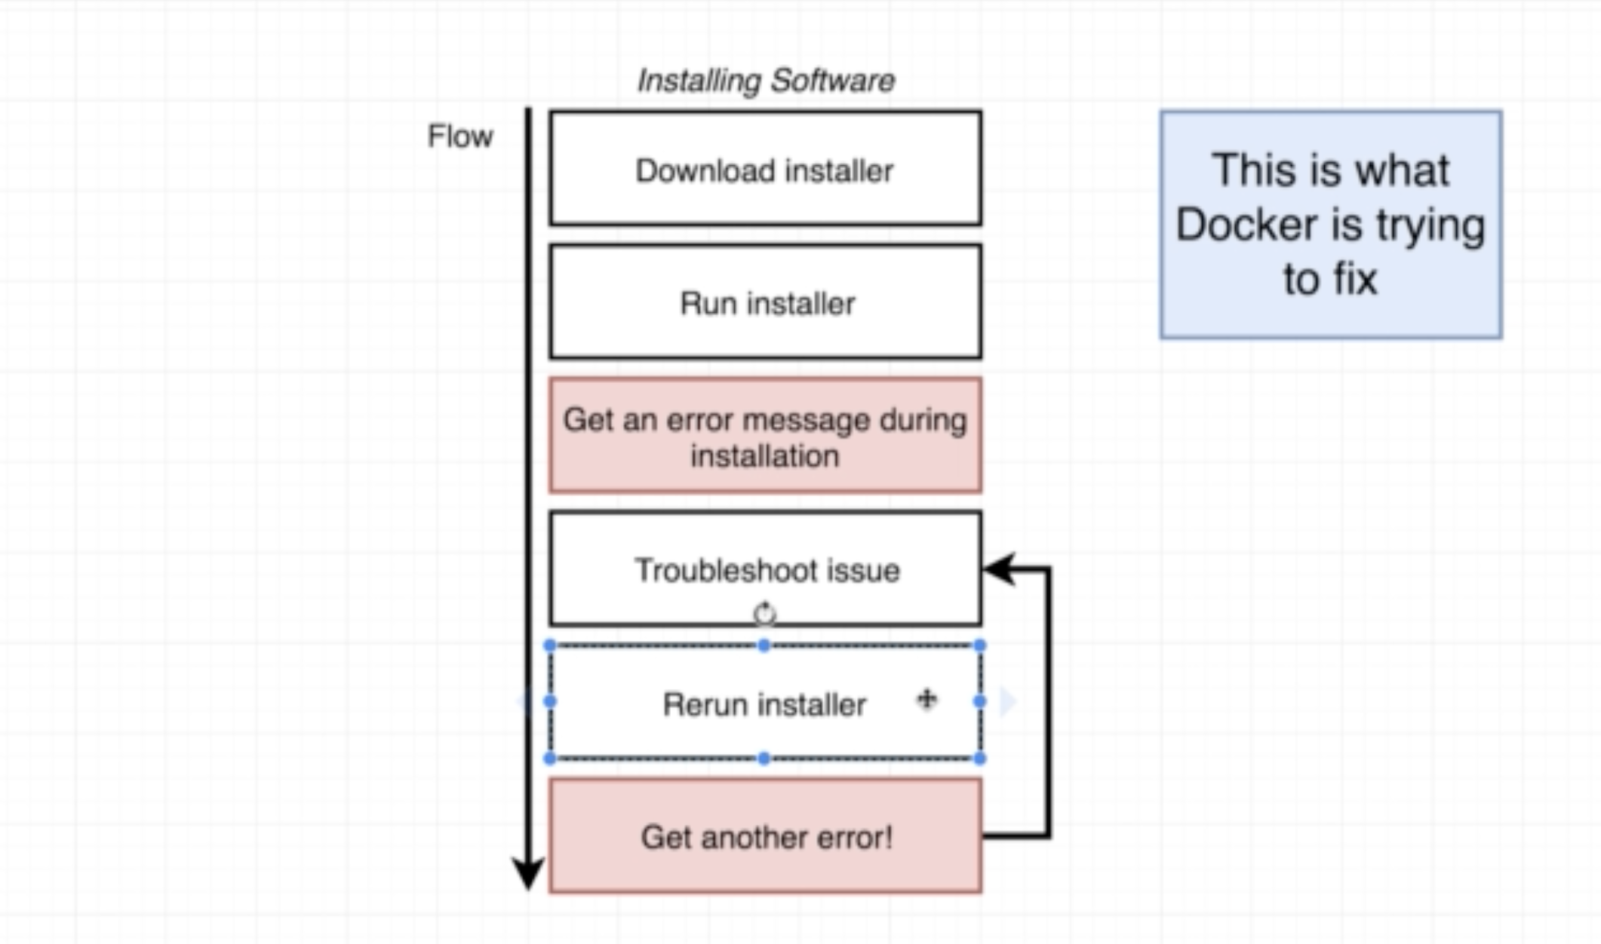
Why
It is very easy to install any software container compare to installing it on machine i.e. docker run redis will install redis
Same thing can also be achieved by VM

Slide 4
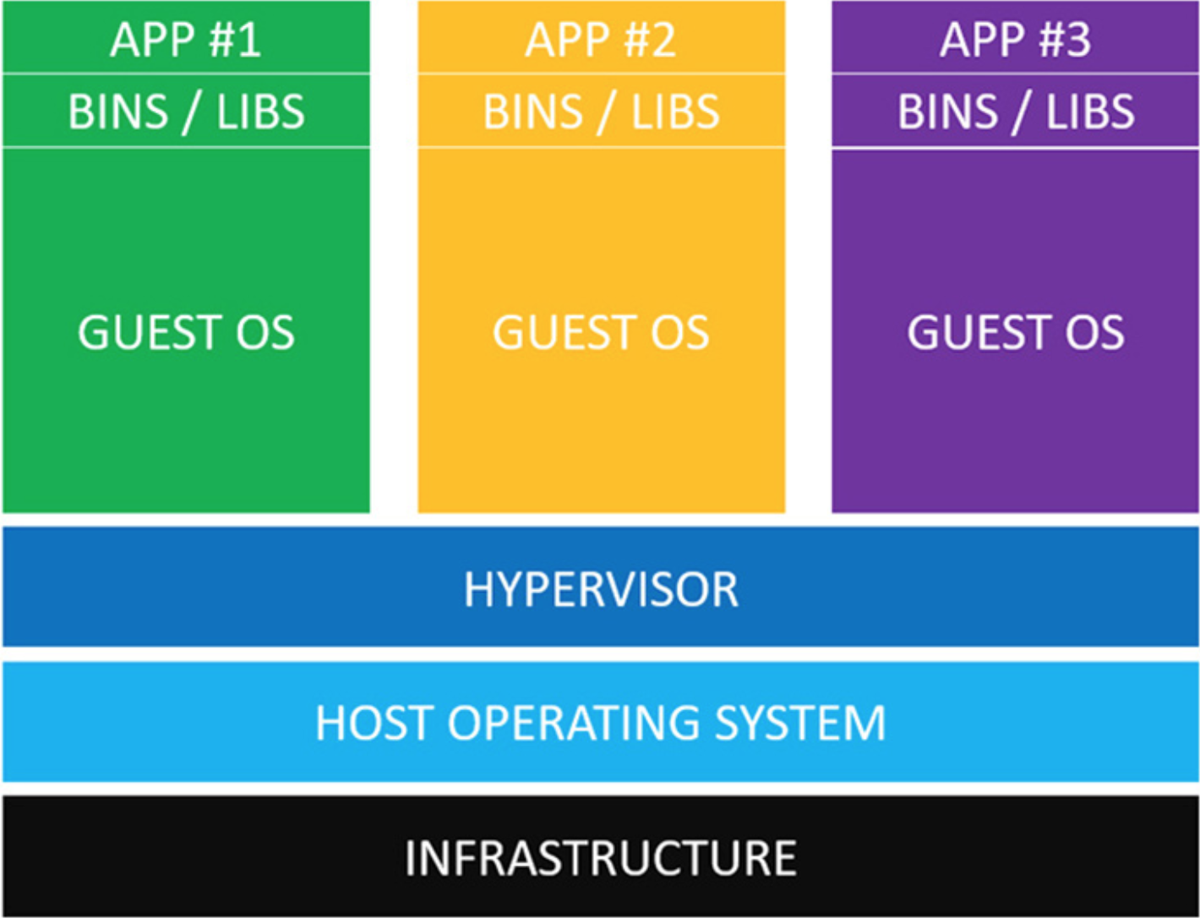
Life with VM
Additional OS Needed
More bootup needed compare to container

Slide 5
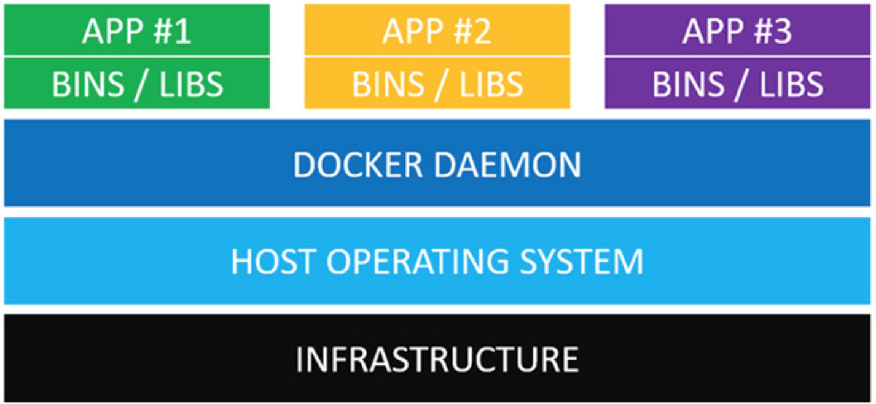
Docker
No Additional OS needed
Dependent on Kernel

Slide 6
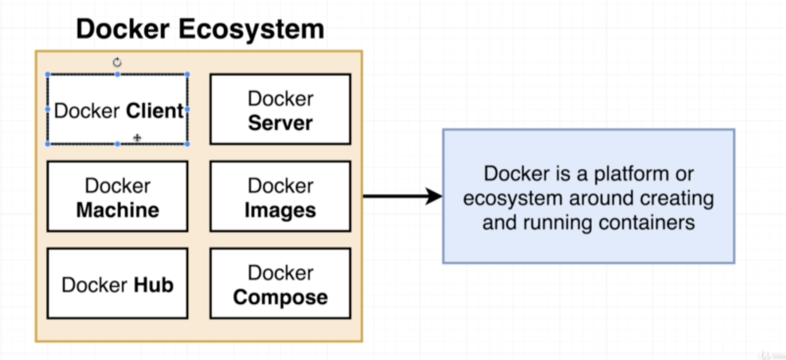
What
Docker is collections of technology that helps in creating/managing container

Slide 7
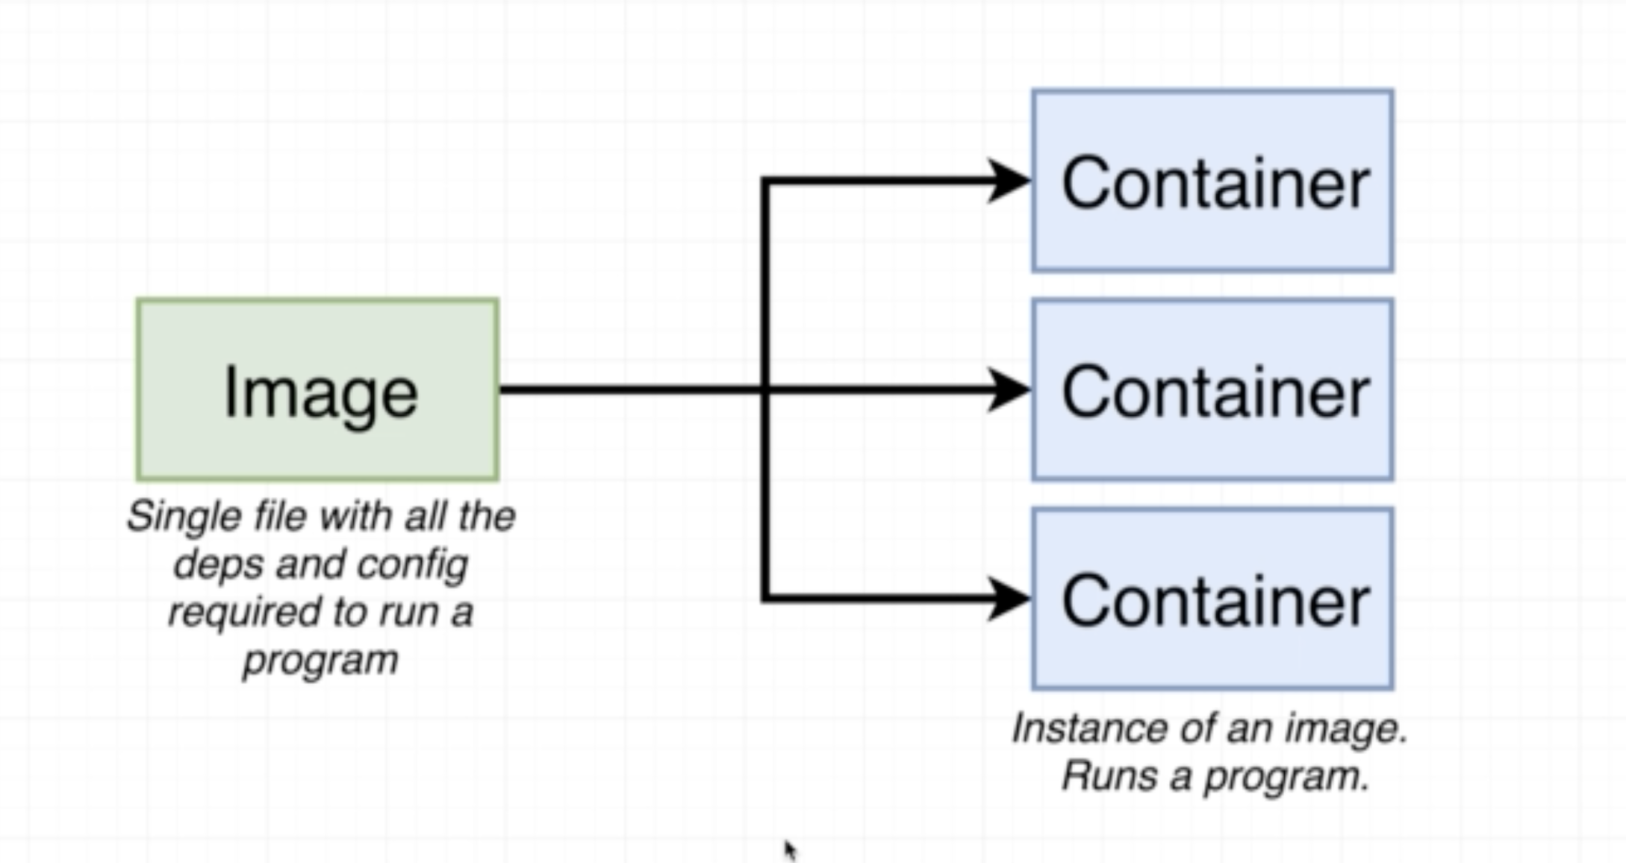
Eco System
Image – Collections of layers. Each layer has some file’s snapshot , config or commands. All layers will be read only
Container – This is an running Image + R/W layer
Both can be created by another one. i.e. Build Image process .

Slide 8
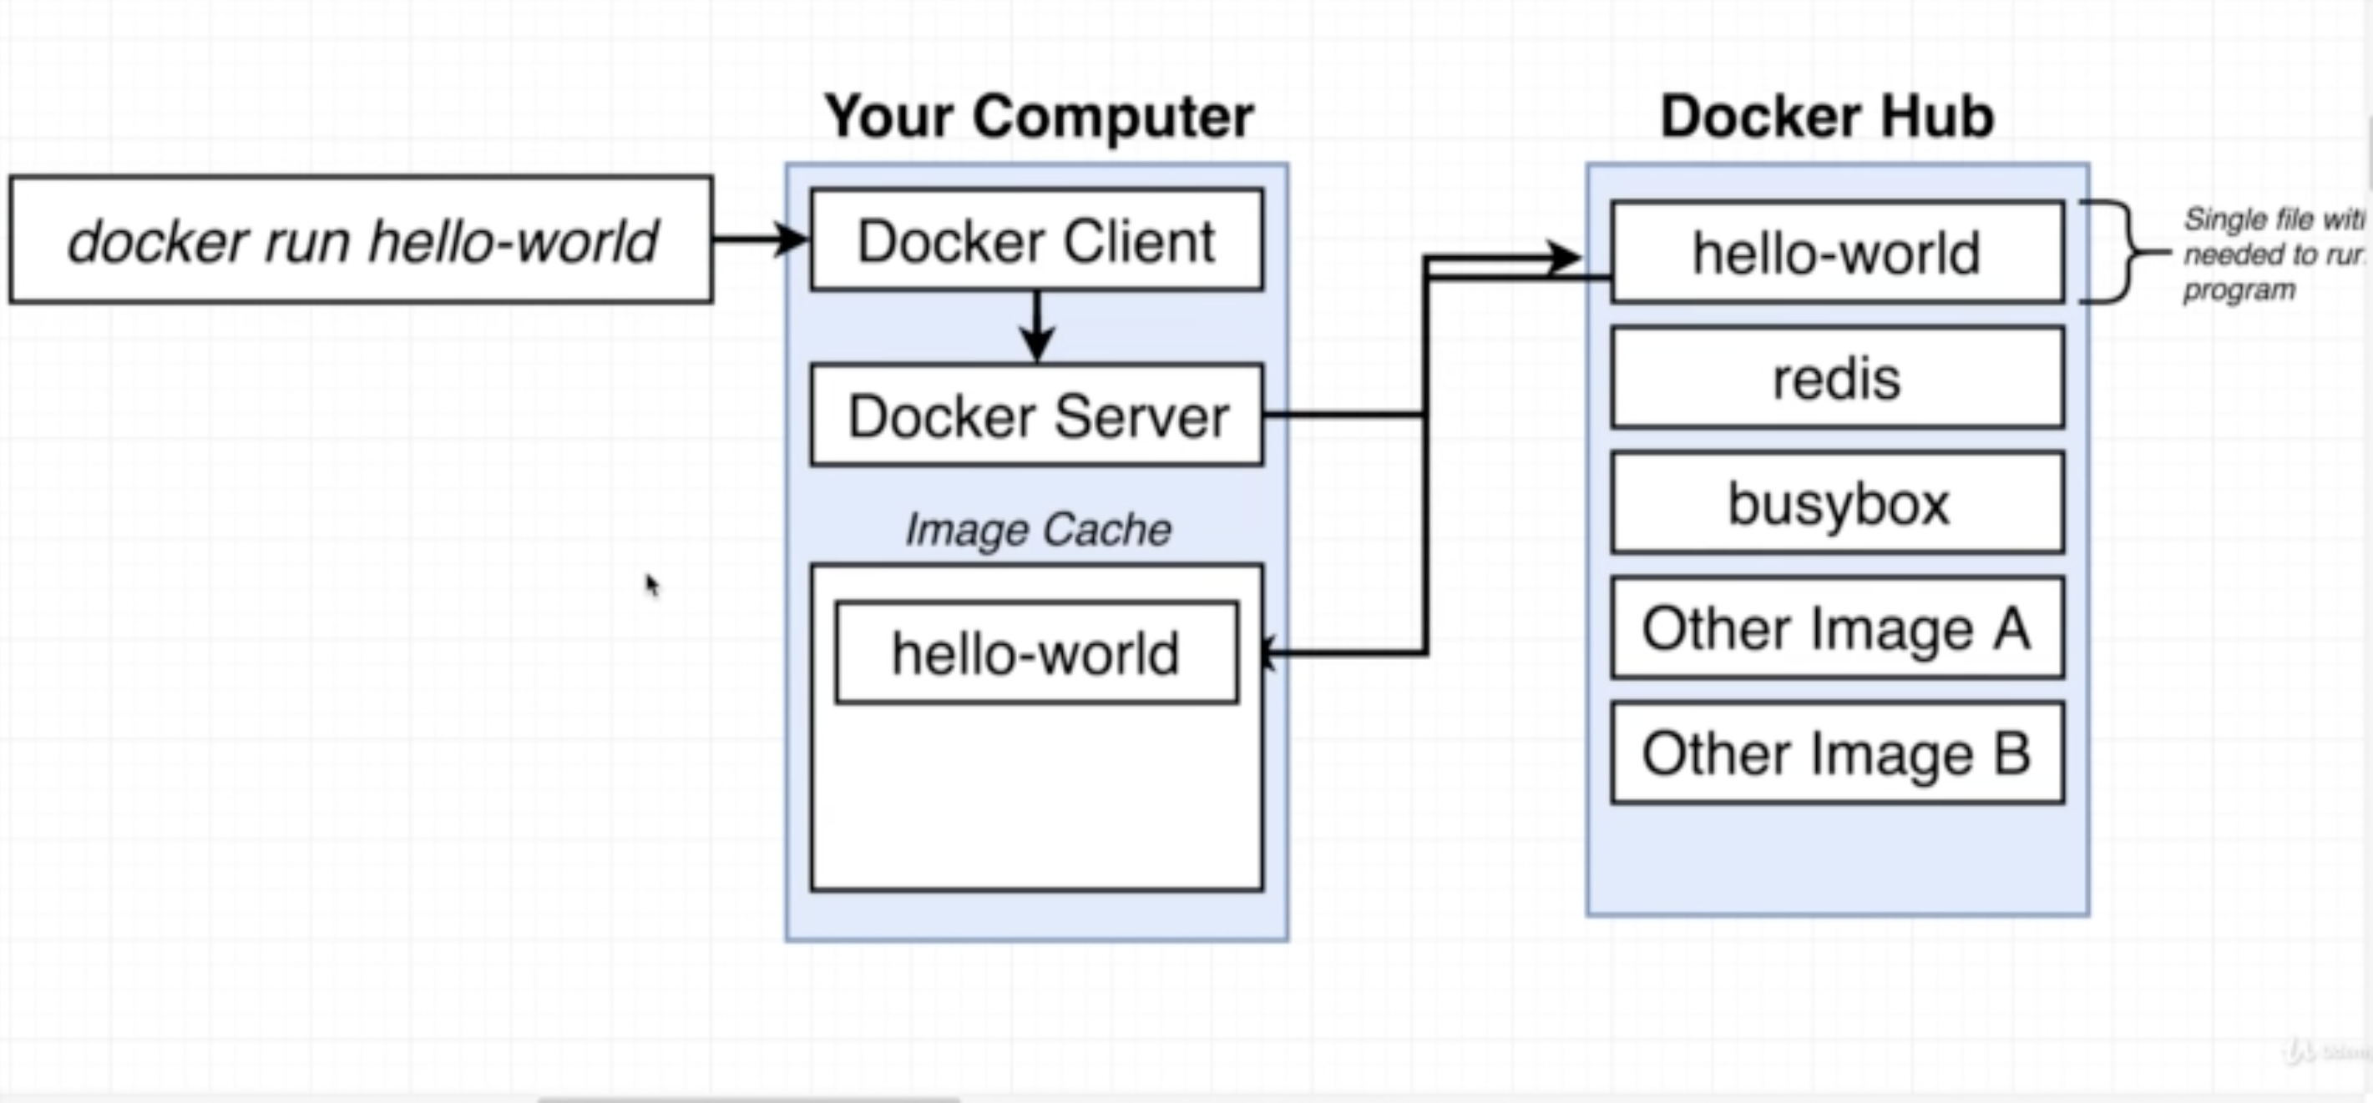
Eco System
Docker Cli – is set of commands to communicate with docker server
Docker server – is a process running in linux kernel which will perform all operations related to image , container , network and volume .

Slide 9
Eco System
Docker Hub– is a repository to store all images. This can be created at enterprise level also
Docker compose – is also a set of cli that is used in case of managing multiple container
Docker Machine – is set of remote docker server configurations. Only one configuration will be activate at once .

Slide 10
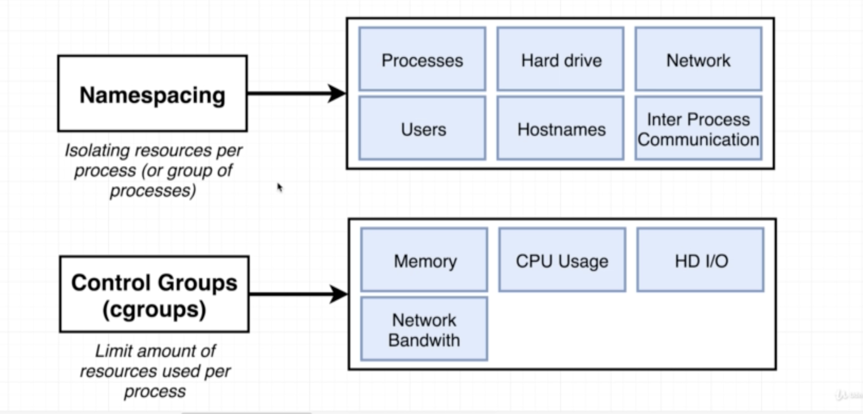
How does container work ?
Every Container runs as a separate process in isolation. Name-spacing provides isolation between multiple container process.
Control-group is used to allocate dedicated resources .
Each Container run in a separate process tree which can not see its parent/sibling processes.

Slide 11
Docker Objects
Image
Container
Network
Volume
Format to run Docker command
Docker <Object> <command> <options> <ObjectId/ObjectName>

Slide 12
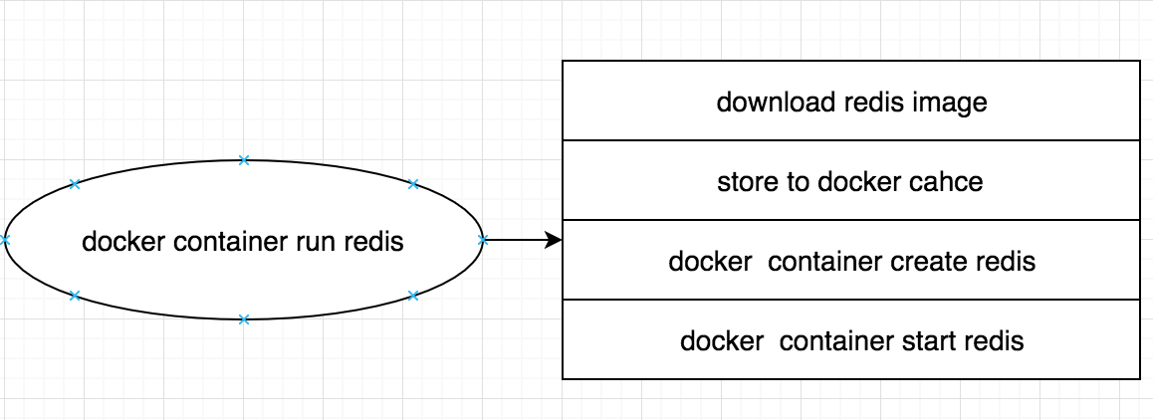
Container
This command will start a redis container in linux VM
“docker exec -it <containerId> sh” will give a console inside container
containerId can be get from “docker ps”
Run “redis-cli”
“set name ABC”
“get name”

Slide 13
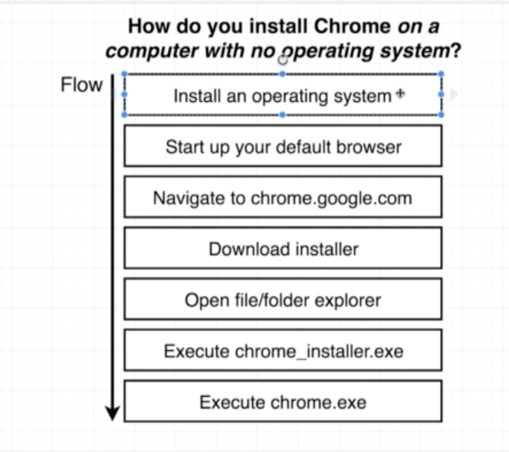
Container – Docker file
Dockefile consist of three main Part
# Base Image
# Required Dependencies
# Default Command to run

Slide 14
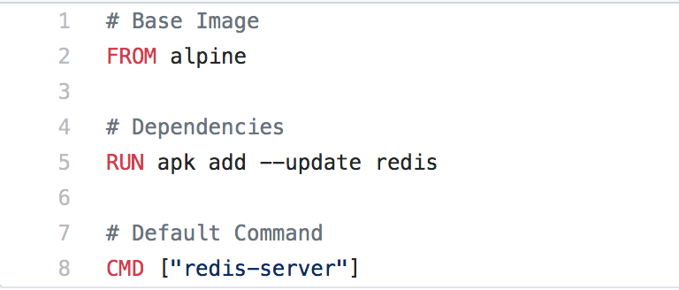
Container – Docker file
Github Link :
https://github.com/mayshukl/docker/blob/master/CustomRedis/Dockerfile
“docker build .”
“docker container run <ImgaeId>”

Slide 15
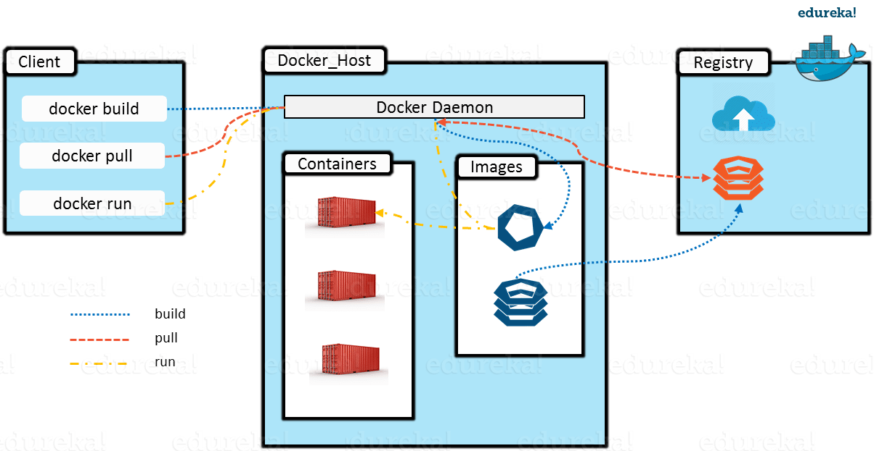
Command Execution Path

Slide 16
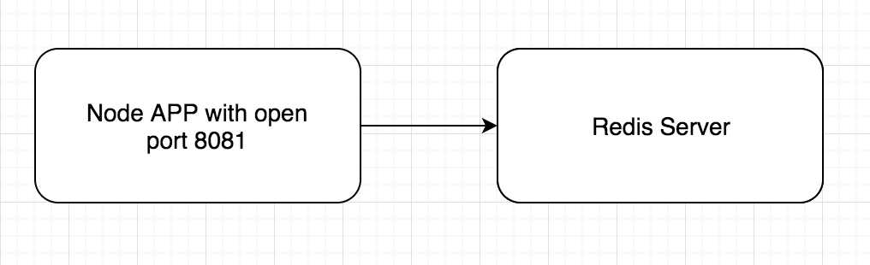
Docker Compose
Docker compose create a default network
Github :
https://github.com/mayshukl/docker/tree/master/VisitCounter

